Slide 1

GAME RECOMMENDATION SYSTEM USING MACHINE LEARNING ALGORITHMS
Advisor: Dr. Serdar ARSLAN
Kutay KABADAŞ 201711039
Tolga BOLAT 201711008
Berfin VARLI 201711068

Slide 2
CONTENTS
INTRODUCTION
PURPOSE
HYBRID RECOMMENDATION SYSTEM
TECHNOLOGIES USED
SIMILAR PROJECTS
WORK DISTRIBUTION
SUCCESS CRITERIA AND RESULTS
CONCLUSION
PROJECT SCREENSHOTS
DEMO

Slide 3
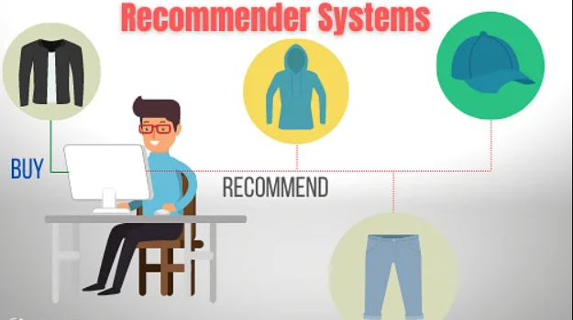
INTRODUCTION
Recommendation systems are algorithms that aim to suggest relevant items to users.

Slide 4
PURPOSE
The aim of this project is to develop a system that can give game recommendations to people who are looking for games they may like based on the games they have liked before or the users that have similar history with the current user.
Main Features:
Predicting games that user might enjoy.
Rate for users.
Display and search among the database for games.

Slide 5
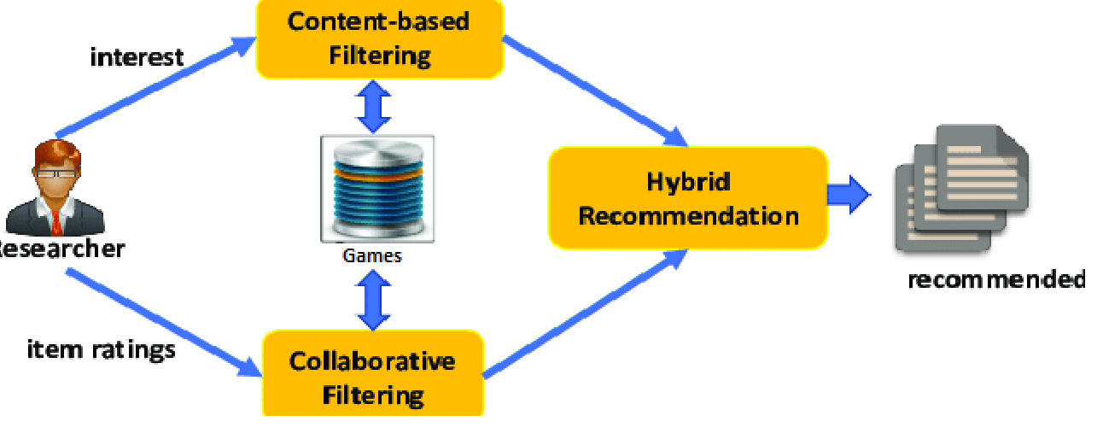
HYBRID RECOMMENDATION SYSTEM
This method combines both content-based filtering and collaborative filtering methods. It either independently combines or combines them into a single model.

Slide 6




TECHNOLOGIES USED
Python – ML Algorithms
LightFM – The Library for ML Evaluation
Firebase Database – Database for User Statistic
React-Native – Mobile App Development Tool

Slide 7




SIMILAR PROJECTS
Steam’s Recommendation System - Collaborative
Netflix’s Recommendation System – Hybrid
IMDb’s Recommendation System - Hybrid
Amazon’s Recommendation System - Collaborative

Slide 8
WORK DISTRIBUTION
Tasks | Done By
Tests | Kutay Kabadaş – Tolga Bolat – Berfin Varlı
React Native | Kutay Kabadaş – Tolga Bolat
Flask API | Kutay Kabadaş – Berfin Varlı
Recommendation Algorithm | Tolga Bolat – Kutay Kabadaş – Berfin Varlı
Dataset Modification | Berfin Varlı

Slide 9
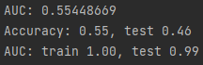
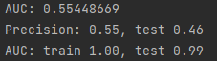
SUCCESS CRITERIA AND RESULTS
Success Criteria | How To Measure | Results
Accuracy Of Game Recommendations | Area Under the ROC Curve metric used.
Simple And Responsive Interface | Offline model training. | System’s interface is easy to use and responsive.
IOS and Android Integration | Both testing emulators and real devices | Both IOS and Android works as expected.

Slide 10
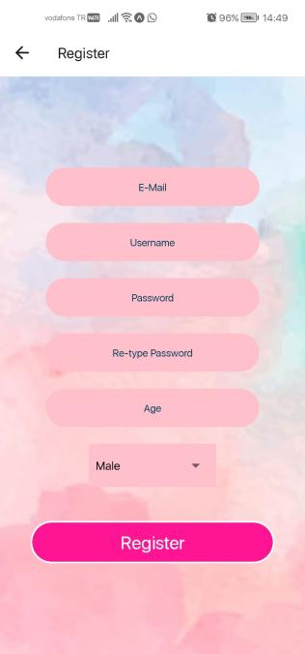
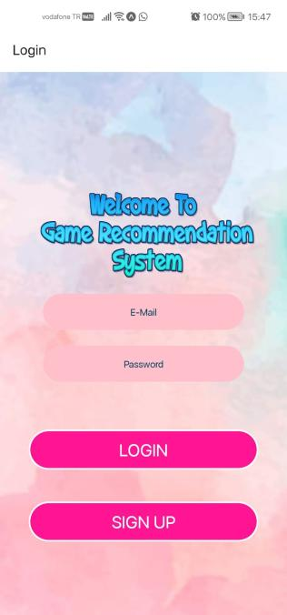
PROJECT SCREENSHOTS
Register and Login Pages

Slide 11
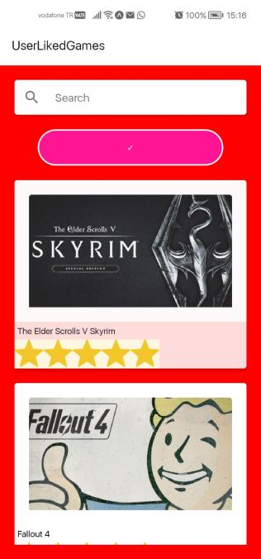
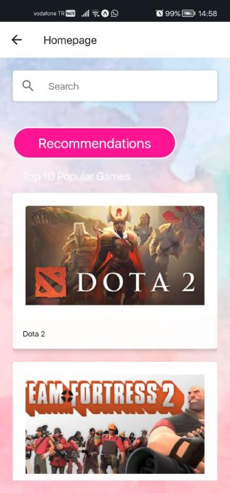
PROJECT SCREENSHOTS
User Liked Games Page and Homepage

Slide 12
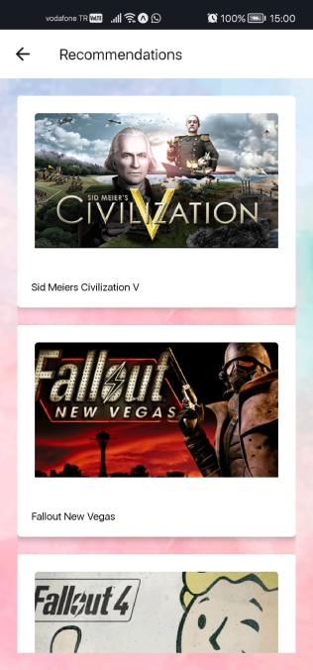
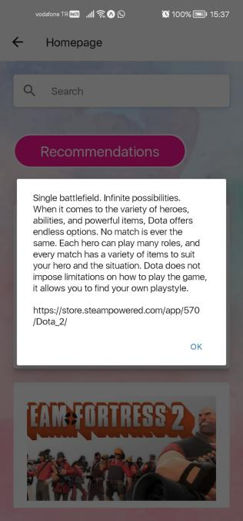
PROJECT SCREENSHOTS
Recommendations Page and Game Profile

Slide 13

CONCLUSION

Slide 14
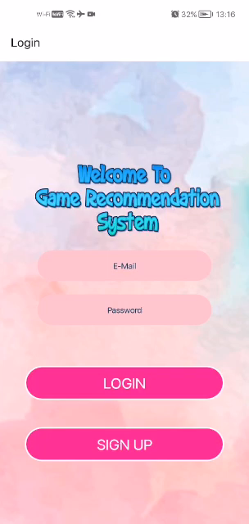
DEMO

Slide 15

THANK YOU FOR LISTENING!

